Slide 1
Crime Data Analysis – November 2024
Subtitle: A Statistical Review of Crime Trends and Patterns Presented by: M. Srineela Reddy (2211CS010335), Group 4

Slide 2
Introduction
Overview
The dataset offers a comprehensive analysis of reported crimes for November 2024.
It includes detailed records of various crimes, helping in identifying patterns and trends.
Objectives of the Analysis
Understand crime trends: Identify the rise or decline in different crime categories over time.
Evaluate law enforcement responses: Analyze the number of arrests and compare it with reported cases.
Detect high-crime areas: Identify geographic locations where crimes are frequently reported.
Analyze severity levels: Determine which crimes have a higher impact on public safety.
Identify time-based patterns: Study the time of occurrence to detect peak crime hours and seasonal variations.

Slide 3
Key Aspects Covered
Crime Categories: Classification of offenses into Theft, Assault, Homicide, Fraud, etc.
Location Data: Identifying crime-prone areas and hotspots.
Arrest & Case Reports: Evaluating law enforcement efficiency by comparing reported cases vs. solved cases.
Crime Severity: Understanding the impact of different crimes using severity scores (if available).
Time-Based Trends: Analyzing daily, weekly, and monthly patterns in crime occurrences.
This analysis aims to provide insights that can help in crime prevention, better resource allocation, and policy-making for law enforcement agencies.

Slide 4
Crime Distribution by Category
Most reported crimes: IPC Crimes, Property Crimes, Crimes Against Women
Graphical representation (bar charts, pie charts)
Identifying crime frequency across different categories

Slide 5
Law Enforcement Efficiency
Comparison of reported cases vs. solved cases
High arrest rates in violent crimes (e.g., homicide, assault)
Lower arrest rates in property crimes and fraud cases

Slide 6
Crime Hotspots & Geographic Analysis
Identifying high-crime areas
Urban centers show more crime density
Heatmap visualization for targeted policing

Slide 7
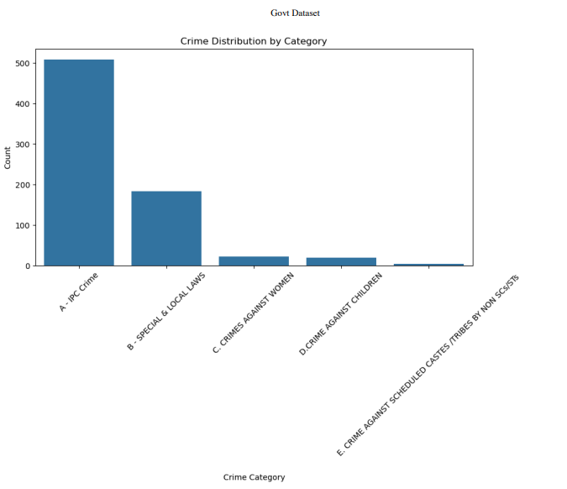
Crime Distribution by Category (Bar Chart)

Slide 8
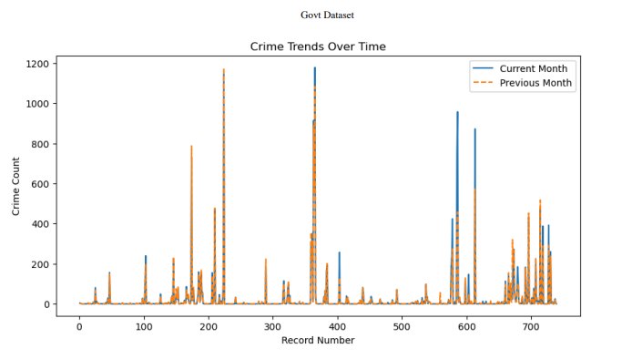
Crime Trends Over Time

Slide 9
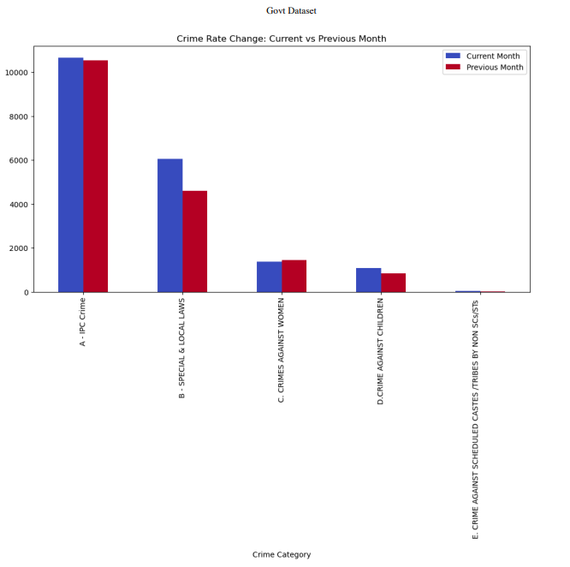
Crime Rate Change (Current vs Previous Month)

Slide 10
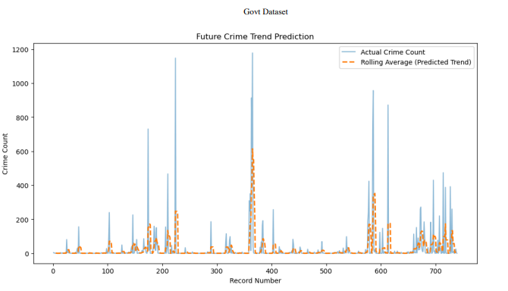
Detecting Unusual Crime Spikes

Slide 11
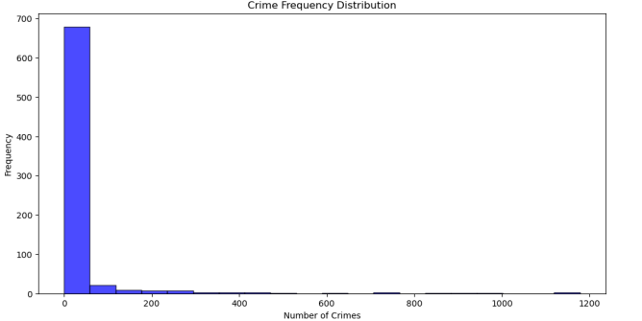
Crime Frequency Distribution

Slide 12
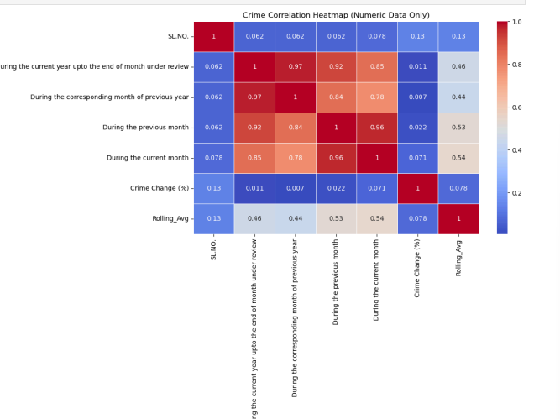
Heatmap (Correlation Between Different Crimes)

Slide 13
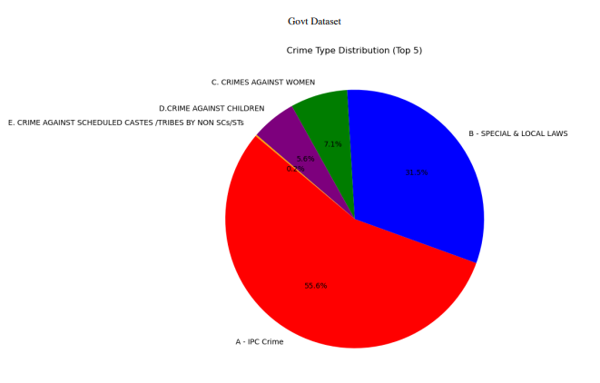
Pie Chart (Crime Type Distribution)

Slide 14
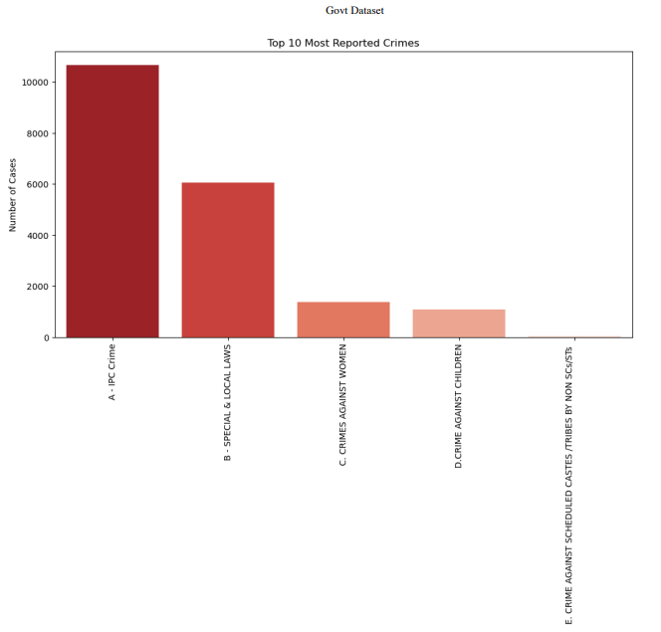
Top 10 Crime Categories

Slide 15
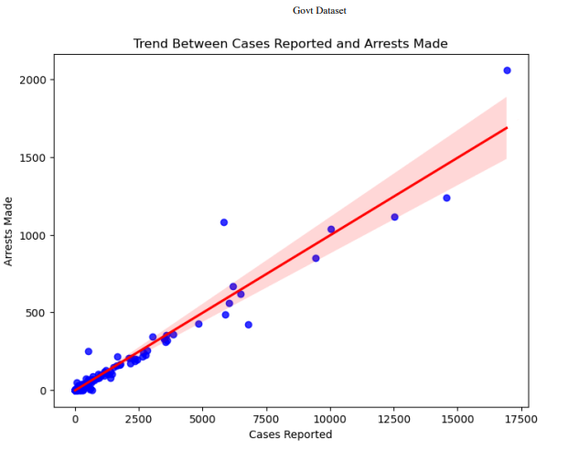
Scatter Plot for identifying trends

Slide 16
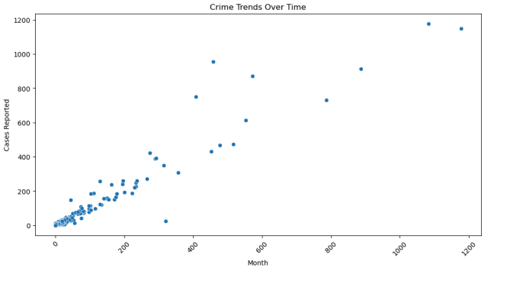
Scatter Plot for Crime Trends Over Time

Slide 17
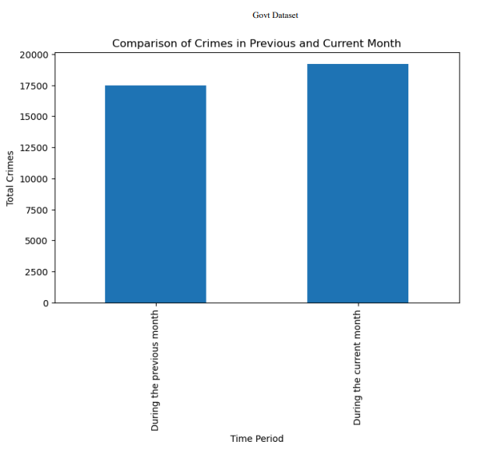
Comparing Crimes in Different Months (Bar Chart for Different Periods)

Slide 18
Key Insights & Recommendations
High-risk categories: IPC Crimes & Property Crimes
Peak crime periods: Nighttime and weekends
Improvement areas: Enhance law enforcement in low-arrest zones
Predictive policing: Use data to allocate resources efficiently

Slide 19
Conclusion
Data-driven approach to crime prevention
Strengthen policing in high-crime areas
Implement predictive analytics for better crime control
Future scope: AI-driven crime analysis for better forecasting

